Slide 1
Section-4 – Personalized Marketing
Chapter 8-Predicting the Likelihood of Marketing Engagement

Slide 2
Introduction
In this chapter, expand the knowledge that gained from the previous chapter and the customer analytics exercise conducted in Chapter 7, Exploratory Analysis for Customer Behavior.
For successful and more intelligent marketing strategies, we cannot stop at analyzing customer data.
With the advanced technology in data science and machine learning, make intelligent guesses and estimates on customers' future behaviors, such as what types of customers are more likely to engage with marketing efforts, the number of purchases that customers are likely to make, or which customers are likely to churn.
These predictions or intelligent guesses that are built based on historical customer data can help to improve marketing performance and further tailor marketing strategies for different target audiences.

Slide 3
Introduction
In this chapter, learn how can utilize data science and machine learning to predict future outcomes and how this can help for future marketing efforts.
This chapter covers the following topics:
Predictive analytics in marketing
Evaluating classification models
Predicting the likelihood of marketing engagement with Python
Predicting the likelihood of marketing engagement with R

Slide 4
Predictive analytics in marketing
Predictive analytics is a process of analyzing and extracting information from historical data to identify patterns and make predictions about future outcomes.
Numerous statistical and machine learning models are typically used to find the relationship between the attributes or features in the dataset and the target variable or behavior that you would like to predict.
Predictive analytics can be utilized and applied in many different industries.
For example, it is often used in the financial industry for fraud detection, where machine learning models are trained to detect and prevent potential fraudulent transactions.
The healthcare industry can also benefit from predictive analytics to help physicians in their decision-making processes.
Furthermore, various parts of marketing can also benefit from predictive analytics, such as customer acquisition, customer retention, and upselling and cross-selling, to name a few.

Slide 5
Predictive analytics in marketing
In predictive analytics, broadly speaking, there are two types of problems:
Classification problems: A classification problem is where there is a set of categories an observation can belong to.
For example, predicting whether a customer is going to open a marketing email or not is a classification problem.
There are only two possible outcomes-opening the marketing email or not opening the email.
Regression problems: A regression problem, on the other hand, is where the outcome can take on any range of real numbers.
For example, predicting customer lifetime value is a regression problem.
One customer can have a lifetime value of $0 and another customer can have a lifetime value of $10,000.
This type of problem, where the outcome can take continuous values, is called a regression problem.

Slide 6
Predictive analytics in marketing
In this chapter, we are going to focus on one of the common classification problems in the marketing industry —predicting the likelihood of customer engagement.
In the following chapter, Chapter 9, Customer Lifetime Value, we are going to tackle one of the frequently appearing regression problems within the marketing industry.
As briefly mentioned previously, there are numerous ways of applying and utilizing predictive analytics in marketing.
In this section, discuss four popular use cases of predictive analytics in marketing:

Slide 7
Applications of predictive analytics in marketing
Likelihood of engagement: Predictive analytics can help marketers forecast the likelihood of customer engagement with their marketing strategies.
For example, if your marketing happens a lot in the email space, you can utilize predictive analytics to forecast which customers have a high likelihood of opening your marketing emails and custom-tailor your marketing strategies to those high-likelihood customers to maximize your marketing results.
For another example, if you are displaying advertisements on social media, predictive analytics can help you identify certain types of customers that are likely to click on the ads.
Customer lifetime value: Predictive analytics can help forecast the expected lifetime values of customers.
Using historical transactional data, predictive analytics can help to identify high-value customers within customer base.
With these predictions, you and your firm can focus more on building healthy relationships with those high-value customers.
We are going to discuss in more detail how to build predictive models for customer lifetime value forecasts in the following chapter

Slide 8
Applications of predictive analytics in marketing
Recommending the right products and contents: Use data science and machine learning to predict which customers are likely to purchase products or view contents.
Using these predictions, improve customer conversion rates by recommending the right products and content for individual customers.
Customer acquisition and retention: Predictive analytics has also been heavily used for customer acquisition and retention.
Based on the profile data gathered about prospects or leads and the historical data of existing customers, apply predictive analytics to identify high-quality leads or rank the leads by their likelihood of being converted into active customers.
On the other hand, use the customer churn data and the historical data of your existing customers to develop predictive models to forecast which customers are likely to leave or unsubscribe from your products.
We are going to discuss in more detail applying predictive analytics for customer retention in Chapter 11
On top of these four common use cases of predictive analytics in marketing, there are many other ways to utilize predictive analytics for marketing strategies.

Slide 9
Evaluating classification models
When developing predictive models, it is important to know how to evaluate those models.
In this section, going to discuss five different ways to evaluate the performance of classification models.
The first metric that can be used to measure prediction performance is accuracy.
Accuracy is simply the percentage of correct predictions out of all predictions, as shown in the following formula:
Accuracy =Number of Correct Predictions/Total number of Records
The second metric that is commonly used for classification problems is precision.
Precision is defined as the number of true positives divided by the total number of true positives and false positives.

Slide 10
Evaluating classification models
True positives are cases where the model correctly predicted as positive, while false positives are cases where the model was predicted as positive, but the true label was negative.
The formula looks as follows:
Precision = TP/TP + FP
Along with precision, recall is also commonly used to evaluate the performances of classification models.
Recall is defined as the number of true positives divided by the number of true positives plus false negatives.
False negatives are cases where the model was predicted as negative, but the true label was positive.
Recall can be thought of as a measure of how many of the positive cases are retrieved or found by the model. The formula looks as follows:
Recall = TP/TP + FN

Slide 11
Evaluating classification models
The final two metrics are the receiver operating characteristic(ROC) curve and the area under the curve (AUC).
The ROC curve shows how true positive rates and false positive rates change at different thresholds.
The AUC is simply the total area under the ROC curve.
The AUC ranges from 0 to 1 and a higher AUC number suggests better model performance.
A random classifier has an AUC of 0.5, so any classifier with an AUC higher than 0.5 suggests that the model performs better than random predictions.
A typical ROC curve looks as in the following:

Slide 12
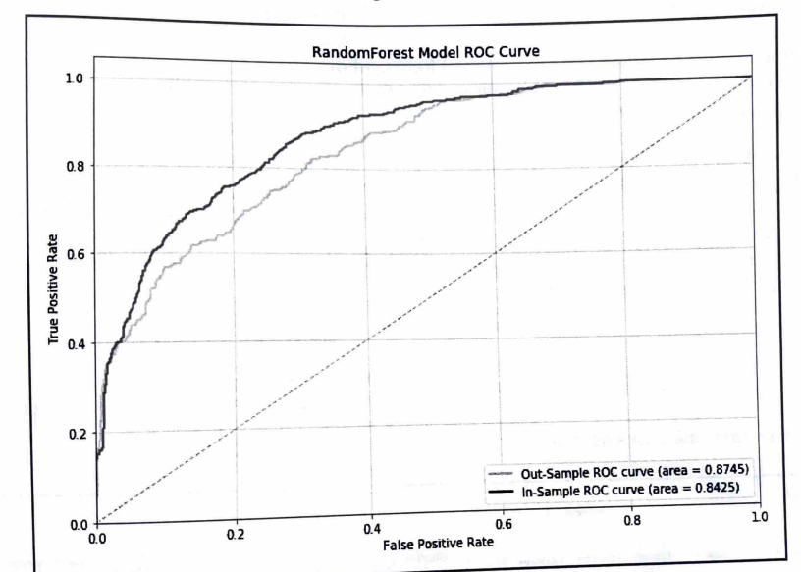
Evaluating classification models

Slide 13
Predicting the likelihood of marketing engagement with Python
In this section, going to discuss how to build predictive models using machine learning algorithms in Python.
More specifically, will learn how to build a predictive model using the random forest algorithm, as well as how to tune the random forest model and evaluate the performance of the model.
Mainly using the pandas, matplotlib, and scikit-learn packages to analyze, visualize, and build machine learning models that predict the likelihood of customer marketing engagement.
Use one of the publicly available datasets from IBM, which can be found at this link: https: //www.ibm.com/communities/analytics/watson-analytics-blog/marketing-customer-value-analysis/.
Download the data that is available in CSV format, named WA_Fn UseC_ Marketing Customer Value Analysis. csv.
Load the data into Jupyter notebook by running the following command:
import pandas as pd
df = pd. read_csv (' ../data/WA_Fn-UseC_-Marketing-Customer-Value-Analysis.csv’)
The df DataFrame looks as follows:

Slide 14
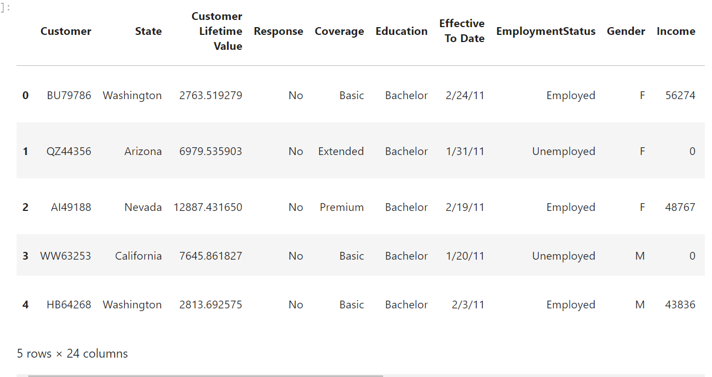
Predicting the likelihood of marketing engagement with Python

Slide 15
Variable encoding
First prepare our data by encoding the target variable and other categorical variables that are going to be used as features for our machine learning models.
To build machine learning models using the scikit-learn package in Python, all the features in the dataset need to have numerical values.
However, in the dataset, numerous columns that have non-numerical values.
For example, the target variable, Response, which is what we are going to try to predict with machine learning models, is non-numeric.
It contains two string values-Yes and No.
Encode this Response target variable with numerical values to be able to build machine learning models.
For another example, the column Gender, which can use as one of the features for our predictive model, also does not have numerical values.
It contains two string values— F for female and M for male.

Slide 16
Response variable encoding
Encode Yes values with 1s and No values with 0s.
Take a look at the following code:
df [ 'Engaged'] = df ['Response']. apply (lambda x: 1 if x == 'Yes' else 0)
Use the apply function of the pandas DataFrame to apply our lambda function on the Response column, so that it encodes Yes values with 1 and No values with 0.
Then store these encoded values in a newly-created column, Engaged.
To get the overall response or engagement rate using this newly-created column, use the following code:
df | 'Engaged' ] .mean ()

Slide 17
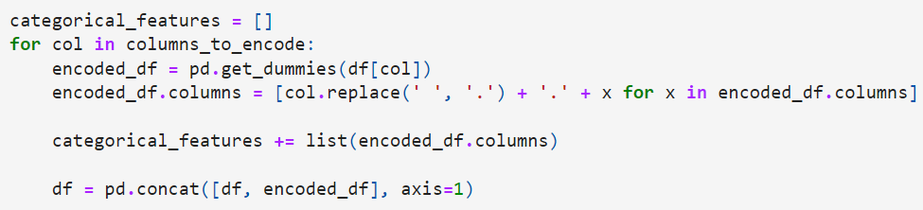
Categorical variable encoding
The following variables are categorical variables:
columns_to_encode = ['Sales Channel', 'Vehicle Size', 'Vehicle Class', 'Policy', 'PolicyType ‘, 'EmploymentStatus', 'Marital Status', 'Education', 'Coverage’]
These variables have a set of different values they can take and those values do not necessarily have orders that differentiate one from another.
There is more than one way to encode categorical variables.
Use get_dummies function in the pandas package to create dummy variables for each category of individual categorical variables.

Slide 18
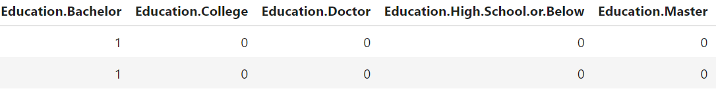
Categorical variable encoding
From this code snippet, iterate through the list of column names of categorical variables, defined in columns_to_encode.
Then, for each column, use the get _dummies function in the pandas package to build dummy variables.
To make things clear and cause less confusion, renaming the columns of the newly-created and encoded DataFrame encoded_df, where each column contains information about the original column name and the category it represents.
As an example, for the Sale Channel column, the newly-created DataFrame encoded_df will look as in the following:

Slide 19
Categorical variable encoding
From this example, each column of this new DataFrame represents each category in the original Sales Channel column and the values are one-hot encoded, meaning it assigns a value of 1 if the given record belongs to the given category, and 0 otherwise.
After creating dummy variables for the given column, then store the newly-created columns in a variable named categorical_features.
Lastly, concatenate this newly-created DataFrame to the original DataFrame, by using the concat function of the pandas package.
One of the parameters in the concat function, axis=1, tells pandas to concatenate the two DataF rames by the column.
By now, successfully encoded all the categorical variables except Gender.
Since we need not to create two dummy variables for the Gender column, as there can only be two genders, create one variable that contains information about the gender of a given record.
Take a look at the following code:
df ['Is.Female'] = df [ 'Gender'] .apply (lambda x: 1 if x == 'F' else 0)
categorical_features. append ('Is. Female’ )

Slide 20
Building predictive models
Take a look at the following code:
all_features = continuous_features + categorical_features
response = 'Engaged’
sample_df = d[all_features + [response]]
sample_df.columns = [x. replace (' ', '.') for x in sample_df. columns]
all_features = [x. replace (' ', '.') for x in all_features]
Creating a new DataFrame sample_df, which contains all the features, all _features, and the response variable, response.
Then, clean up the column and feature names by replacing all the spaces in the names with dots.
After these cleanups, DataFrame sample_df now looks as in the following:

Slide 21
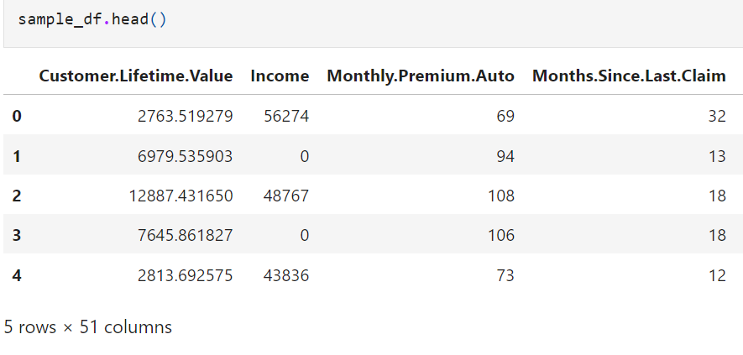
Building predictive models

Slide 22
Building predictive models
Split this sample set into two subsets-one for training the models and another for testing and evaluating the trained models.
The Python machine learning package, scikit-learn, has a function that splits a given sample set into train and test sets.
Take a look at the following code:
from sklearn.model_selection import train_test_split
x_train, x_test, y_train, y_test = train_test_split (sample_df (all_features], sample_d [response], test_size=0.3)

Slide 23
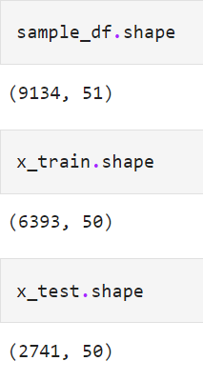
Building predictive models
In the model_selection module of the seikit-learn package, there is a function named train_test_split
This function takes the sample set and the desired breakdown between train and test set sizes as input parameters and returns train and test sets that are randomly split.
In this code snippet, 70% of the sample set for training and the remaining 30% for testing.
The following shows the breakdowns of train and test sets from the sample set:
There are a total of 9, 134 records in sample_df, 6, 393 records in x_train,
and 2, 741 records in x_test, meaning that roughly 70% of the sample set
went into the train set and the remaining 30% of the sample set went into the test set.
Use these train and test sets for building and evaluating models in the following sections.

Slide 24
Random forest model
Build a predictive model, using a random forest algorithm, which predicts whether a customer is going to respond or engage with the marketing campaign.
In Python's scikit-learn package, the random forest algorithm is implemented in the ensemble module and import the random forest class using the following code:
from sklearn.ensemble import RandomForestClassifier
Create a random forest classifier using the following code:
rf_model = RandomForestClassifier ()

Slide 25
Random forest model
However, many hyperparameters can tune for random forest models.
Hyperparameters are the parameters defined before train a machine learning model.
For example, in the case of a random forest algorithm, define the number of trees you want in your random forest model.
As another example, you can define the maximum depth of each tree in the forest, so that limit how big each tree in the forest can grow.
There are numerous hyperparameters can define in scikit-learn'sRandomForestClassifier class.
Following are a few examples of hyperparameters:
n_estimators: This defines the number of trees you want to build in the forest. Generally speaking, more trees mean better performance results.
However, the amount of performance gain for each additional tree decreases as the number of trees in the forest increases.
Since having more trees in a forest means a higher cost in computations for training additional trees, try to find the balance and stop adding trees when the computational cost from training additional trees outweighs the performance gain

Slide 26
Random forest model
max_depth: This parameter defines the maximum depth of individual trees.
The larger the depth is, the more information can be captured from the train set, meaning larger trees learn the train set better than smaller trees.
However, the larger the tree grows, the more likely it is going to overfit the train set.
This means that the trained tree performs and predicts well within the train set, but predicts poorly in the dataset that it has not seen before.
To avoid overfitting, limit the depth of the tree to a point where it does not overfit to the train set, but predicts the outcomes well enough.
min_ samples_split: This defines the minimum number of data points required to split a node of the tree.
For example, if min_samples_split is 50, but the node only has 40 records, then it will not split the node any further.
On the other hand, if the node has more than the predefined minimum number of samples, then it will split the node into child nodes.
Similar to the max _depth hyperparameter, this helps to manage the amount of overfitting happening in the tree.

Slide 27
Random forest model
max_ features: This defines the maximum number of features to be considered for splitting a node.
This parameter creates the randomness in random forest models.
Given the maximum number of features to be considered for a split, the random forest algorithm randomly chooses a subset of the features up to the maximum number and decides how to split a given node of a tree.
This helps each tree of a random forest model to learn different information from the train set.
When these trees that have learned the train set with a slightly different set of features are bagged or ensembled altogether, then the resulting forest will become more accurate and robust in its predictions.

Slide 28
Training a random forest model
Training a random forest model using scikit-learn is simple.
Take a look at the following code:
rf_model = RandomForestClassifier (n_estimators=200, max_depth=5)
rf_model. fit (X=x_train, y=y_train)
Using the RandomforestClasifier class in the scikit-learn package's ensemble module, first need to create a RandomforestClasifier object with the hyperparameters.
For design purposes, we are instructing the model to build 200 trees, where each tree can only grow up to the depth of 5.
Then, train this model with the fit function, which takes two parameters, X and y, where X is for the training samples and y is for the training labels or target values.

Slide 29
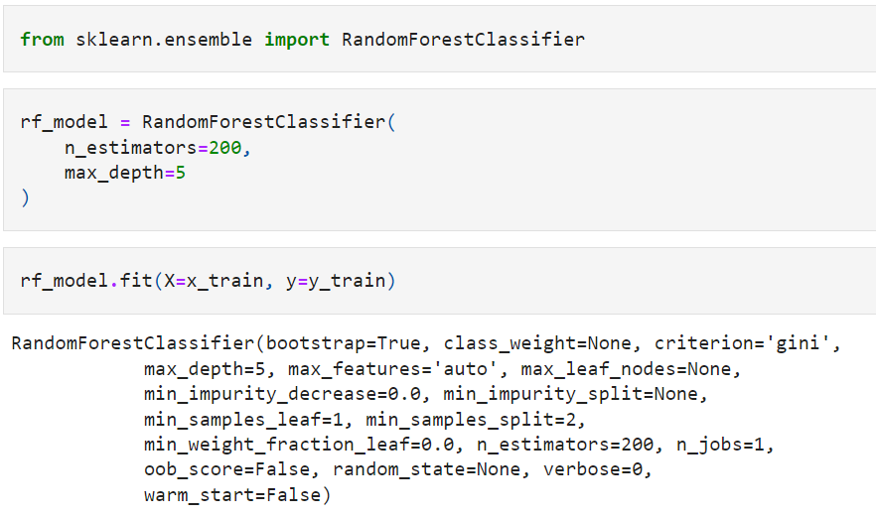
Training a random forest model
The output of model training looks as follows:

Slide 30
Training a random forest model
Once a random forest model is trained or fitted, the model object contains a lot of useful information.
One of the useful attributes extracted from a trained scikit-learn random forest model is the information about individual trees in the forest.
Using the estimators_ attribute, retrieve the individual trees that are built within the forest.
Take a look at the following output:

Slide 31
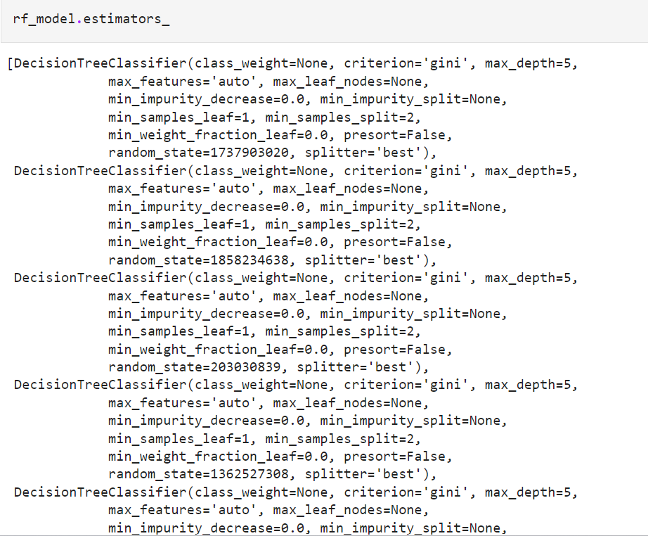
Training a random forest model

Slide 32
Training a random forest model
From the above output, the estimators_ attribute returns a list of sub-estimators, which are decision trees.
With this information, can simulate what each of these sub-estimators predicts for each input.
For example, the following code shows how you can get the predictions from the first sub-estimator in the forest:
rf_model. estimators_[0].predict (x_test)
The following output shows some of the predictions from the first five sub-estimators:

Slide 33
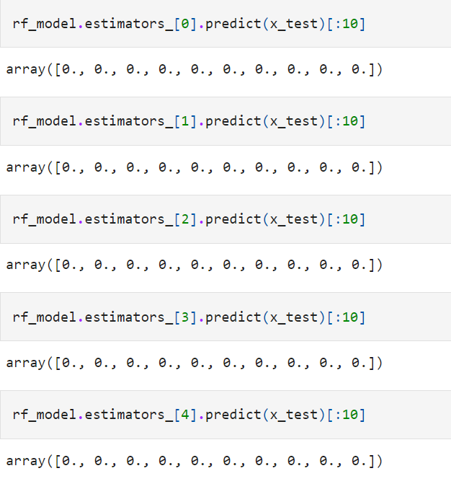
Training a random forest model

Slide 34
Training a random forest model
From this output, different trees predict differently for each record of the test set.
This is because each tree is trained with different subsets of features that are randomly selected.
Let's take a quick look at the predictions of these individual sub-estimators.
The first tree predicts the 6th record in the test set to be a class of 1 and the rest to be a class of 0.
On the other hand, the second tree predicts that the first 10 records of the test set to be a class of 0.
Using this information, the final predictions from the random forest model are formed from these individual sub-estimators or trees.
Other useful information that is gained from the trained RandomForestClassifier object is the feature importances, with which we can understand the importance or the impact of each feature on the final predictions.
You can get the feature importances for each feature using the following code:
rf model. feature_importances_

Slide 35
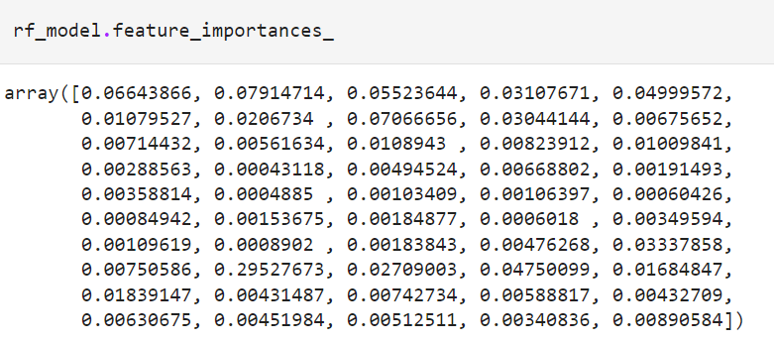
Training a random forest model

Slide 36
Training a random forest model
To associate these feature importances with the corresponding features, use the following code:
feature_importance_df =
pd. DataFrame (list (zip (rf_model. feature_importances_, all_features) ))
feature_importance_df.columns = [' feature, importance', 'feature’]
The result looks as follows
From the output, it is observed that the Employment Status. Retired feature seems to be the most important factor in making the final prediction and the Income, Total. Claim. Amount, and Customer. Lifetime. Value features follow as the second, third, and fourth most important features.

Slide 37
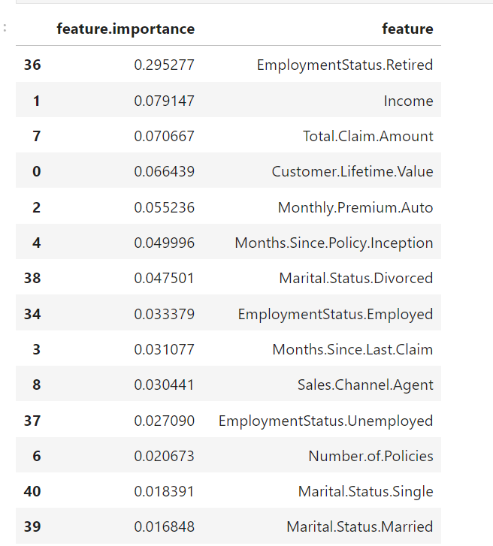
Training a random forest model

Slide 38
Evaluating a classification model
In this section, learn how we can compute and visualize the metrics for evaluating a classification model in Python using the random forest model.
The first three metrics that are going to look at are accuracy, precision, and recall.
Python's scikit-learn package has implemented functions for these three metrics.
Import these functions using the following line of code:
from sklearn.metrics import accuracy_score, precision_score, recall_score
As you can see from this code snippet, the metrics module of the scikit-learn package has an accuracy_score function for calculating the accuracy of a model, a precision_score function for the precision, and a recall_score function for the recall.

Slide 39
Evaluating a classification model
Before evaluation, use the predict function for making predictions of the model.
Take a look at the following code:
in_sample_preds = rf_model predict (x_train)
out_sample_preds = rf_model predict (x_test)
With these prediction results, evaluate how well our random forest model performs in the train and test sets.
The following code shows the syntax of the accuracy_score, precision_score, and recall_ score functions in the scikit-learn package:
# accuracy
accuracy_score (actual, predictions)
# precision
precision_score (actual, predictions)
# recall
recall_score (actual, predictions)

Slide 40
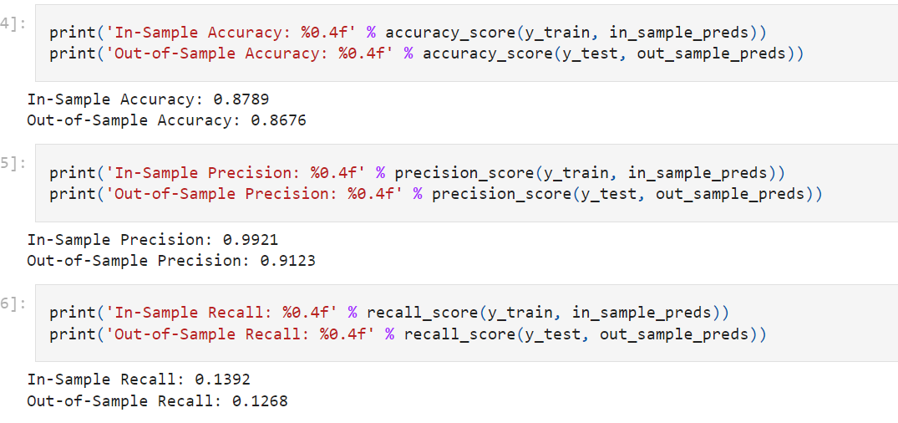
Evaluating a classification model
The accuracy-score, precision_score, and recall_score functions all take two parameters-truth labels and predicted labels.
Take a look at the following output:

Slide 41
Evaluating a classification model
This output gives us a brief overview of how well our model performs at predicting the responses.
For the train set, the accuracy of the overall prediction was 0. 8724, meaning the model prediction was correct for about 87% of the time.
For the test set, the accuracy of the overall prediction was 0. 8818, which is roughly on the same line with the prediction accuracy within the train set.
The precision for in-sample and out-of-sample predictions were 0. 9919 and 0. 9423 respectively, and the recalls were 0. 1311 and 0. 1324.
Due to the randomness and the different hyperparameters used, get different results.
The next set of metrics are the ROC curve and the AUC.
The metrics module in the scikit-learn package has handy functions for the ROC curve and the AUC.
Take a look at the following line of code:
from sklearn.metrics import roc_curve, auc

Slide 42
Evaluating a classification model
The roc_curve function in the metrics module of the scikit-learn package computes the ROC, and the auc function computes the AUC.
To compute the ROC and AUC using these functions, first get the prediction probabilities from our random forest model.
The following code shows how can get the random forest model's prediction probabilities for both the train and test sets:
in_sample_preds = rf_model predict_proba (x_train) (:, 1]
out_sample_preds = rf_model predict_proba (x_test) (:, 1]
predict_proba function outputs the predicted probabilities of the given record belonging to each class.
Since we only have two possible classes in our case, 0 for no responses and 1 for responses, the output of the predict_proba function has two columns, where the first column represents the predicted probability of a negative class, meaning no response for each record, and the second column represents the predicted probability of a positive class, meaning a response for each record.

Slide 43
Evaluating a classification model
Since we are only interested in the likelihood of responding to the marketing effort, we can take the second column for the predicted probabilities of the positive class.
With these predicted probabilities of the positive class for both the train and test sets, compute the ROC curve and AUC.
Compute the ROC curve using the roc_curve function in the following code:
in_sample_fpr, in_sample_tpr, in_sample_thresholds = roc_curve (y_train,in_ sample_preds)
out_sample_fpr, out_sample_tpr, out_sample_thresholds = roc_curve (y_test,out_sample_preds)
The roc_curve function takes two parameters- observed labels and predicted probabilities.
This function returns three variables, fpr, tpr, and thresholds. The fpr values represent the false positive rates for each given threshold and the tpr values represent the true positive rates for each given threshold.
The thresholds values represent the actual thresholds at which fpr and tpr are measured.

Slide 44
Evaluating a classification model
Next, with these fpr and tpr values, compute the AUC using the following code:
in_sample_roc_auc = auc (in_sample_fpr, in_sample_tpr)
out_sample_roc_auc = auc (out_sample_fpr, out_sample_tpr)
print ('In-Sample AUC: %0.4f' & in_sample_roc_auc)
print ('Out-Sample AUC: 80.4f' & out_sample_roc_auc)
The auc function takes two parameters— fpr and tpr.
Using the previously calculated fpr and tpr values from the roc_curve function, easily compute the AUC numbers for both the train and test sets. The output looks as follows:

Slide 45
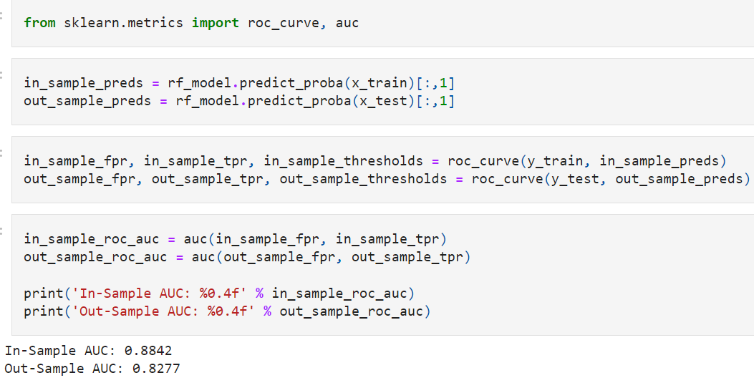
Evaluating a classification model

Slide 46
Evaluating a classification model
Depending on the hyperparameters and the randomness within the random forest algorithm, AUC numbers can look different from these examples.
However, in our case, the in-sample train set AUC was 0.8745 and the out-of-sample test set AUC was 0. 8425.
If you see a big gap between these two numbers, it is a sign of overfitting, and try to address it by pruning the trees in the forest by tuning the hyperparameters, such as the maximum depth and minimum number of samples to split.
The last thing for evaluating machine learning models is the actual ROC curve.
With the output of the roc_curve function, plot the actual ROC curves using the matplot lib package.

Slide 47
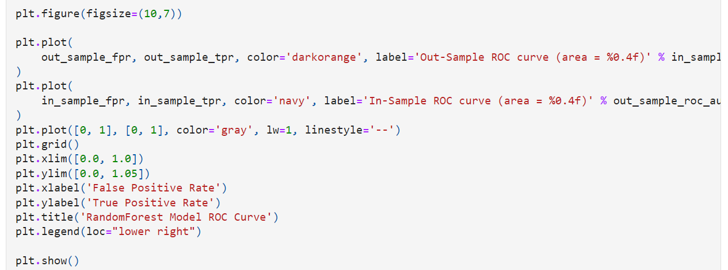
Evaluating a classification model

Slide 48
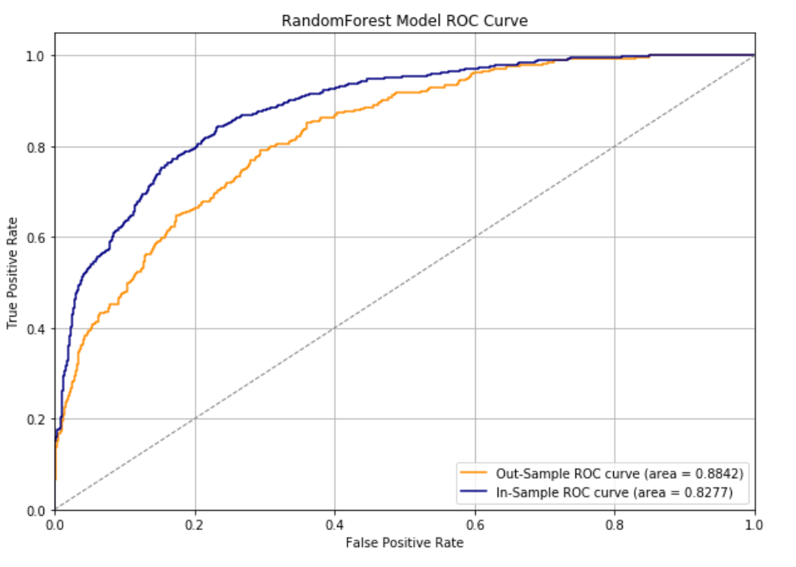
Evaluating a classification model

Slide 49
Evaluating a classification model
Plotting three line plots one for the out-of-sample test set ROC curve, another for the in-sample train set ROC curve, and lastly one for a straight line for the benchmark.
From this plot, it is easier to see and compare the overall performance of the model between the train and test sets with ROC curves.
The larger the gap between the in-sample ROC curve and the out-of-sample ROC curve, the more the model is overfitting to the train set and fails to generalize the findings for unforeseen data.

Slide 50
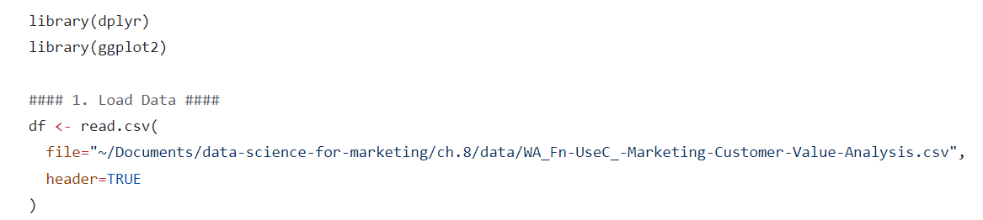
Predicting the likelihood of marketing engagement with R

Slide 51
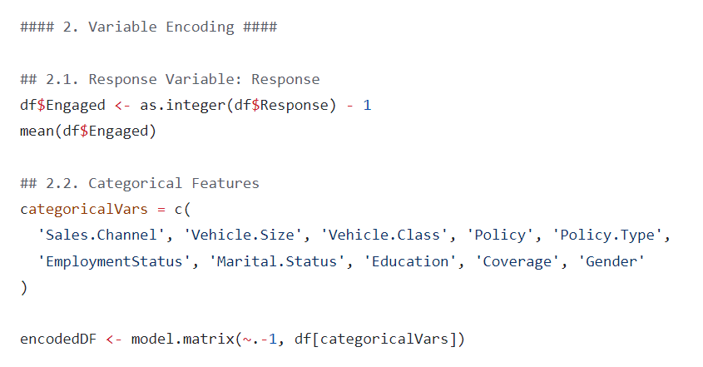
Predicting the likelihood of marketing engagement with R

Slide 52
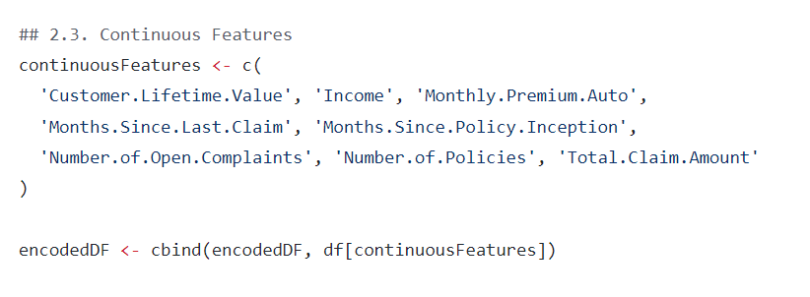
Predicting the likelihood of marketing engagement with R

Slide 53
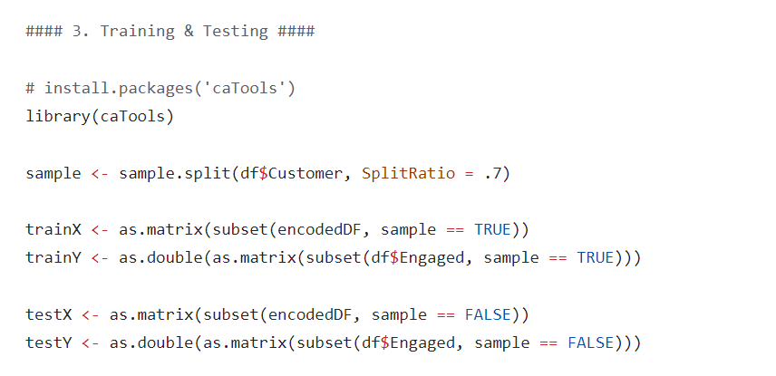
Predicting the likelihood of marketing engagement with R

Slide 54
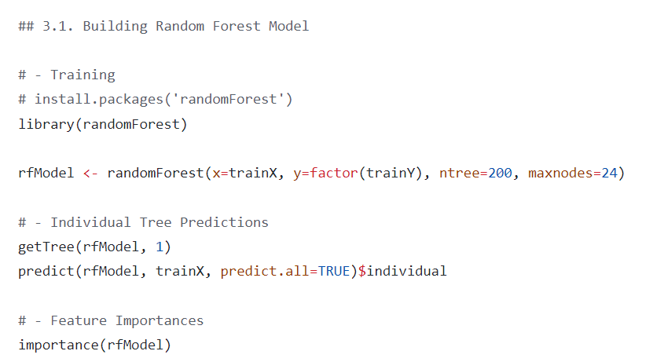
Predicting the likelihood of marketing engagement with R

Slide 55
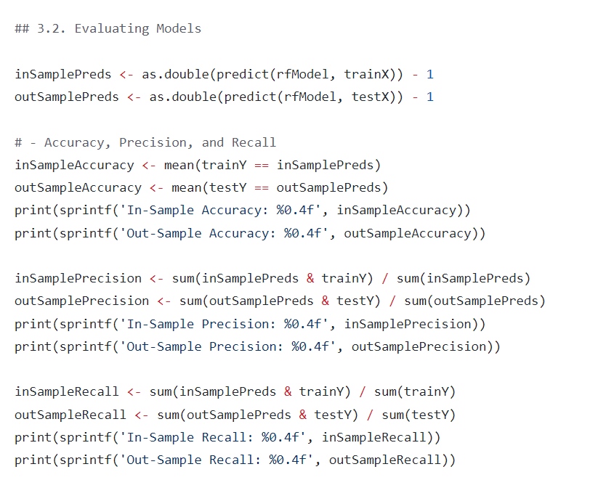
Predicting the likelihood of marketing engagement with R

Slide 56
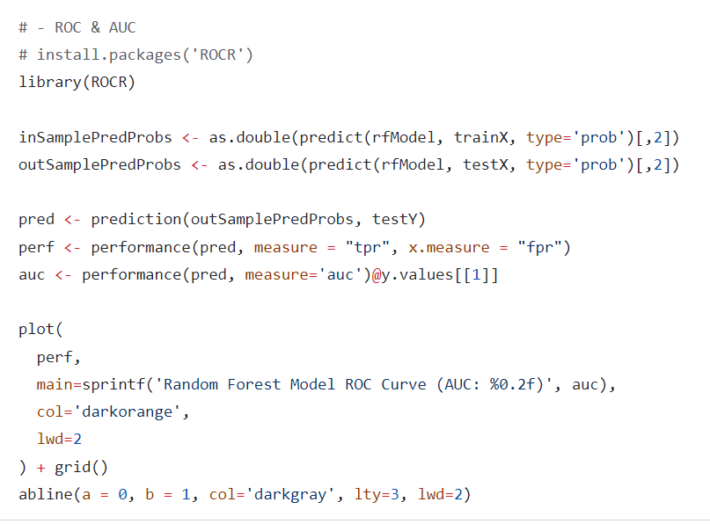
Predicting the likelihood of marketing engagement with R

